Slide 1
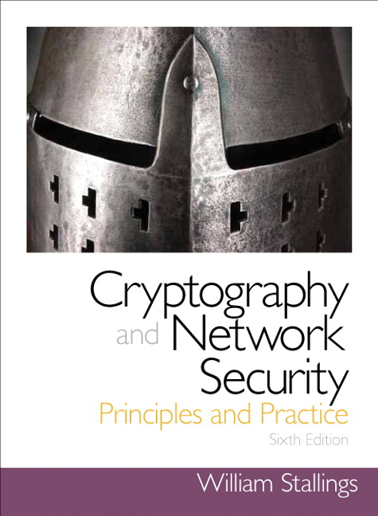
Cryptography and Network Security
Seventh Edition
by William Stallings
Notes:
Lecture slides prepared for “Cryptography and Network Security”, 7/e, by William Stallings, Chapter 7 – “Block Cipher Operation”.

Slide 2
Chapter 7
Block Cipher Operation
Notes:
This chapter continues our discussion of symmetric ciphers. We begin with the topic of
multiple encryption, looking in particular at the most widely used multiple-encryption
scheme: triple DES.
The chapter next turns to the subject of block cipher modes of operation. We
find that there are a number of different ways to apply a block cipher to plaintext, each
with its own advantages and particular applications.

Slide 3
Modes of Operation
A technique for enhancing the effect of a cryptographic algorithm or adapting the algorithm for an application
To apply a block cipher in a variety of applications, five modes of operation have been defined by NIST
The five modes are intended to cover a wide variety of applications of encryption for which a block cipher could be used
These modes are intended for use with any symmetric block cipher, including triple DES and AES
Notes:
A block cipher takes a fixed-length block of text of length b bits and a key as input
and produces a b -bit block of ciphertext. If the amount of plaintext to be encrypted
is greater than b bits, then the block cipher can still be used by breaking the plaintext
up into b -bit blocks. When multiple blocks of plaintext are encrypted using the
same key, a number of security issues arise. To apply a block cipher in a variety of
applications, five modes of operation have been defined by NIST (SP 800-38A).
In essence, a mode of operation is a technique for enhancing the effect of a cryptographic
algorithm or adapting the algorithm for an application, such as applying
a block cipher to a sequence of data blocks or a data stream. The five modes are
intended to cover a wide variety of applications of encryption for which a block
cipher could be used. These modes are intended for use with any symmetric block
cipher, including triple DES and AES.

Slide 4
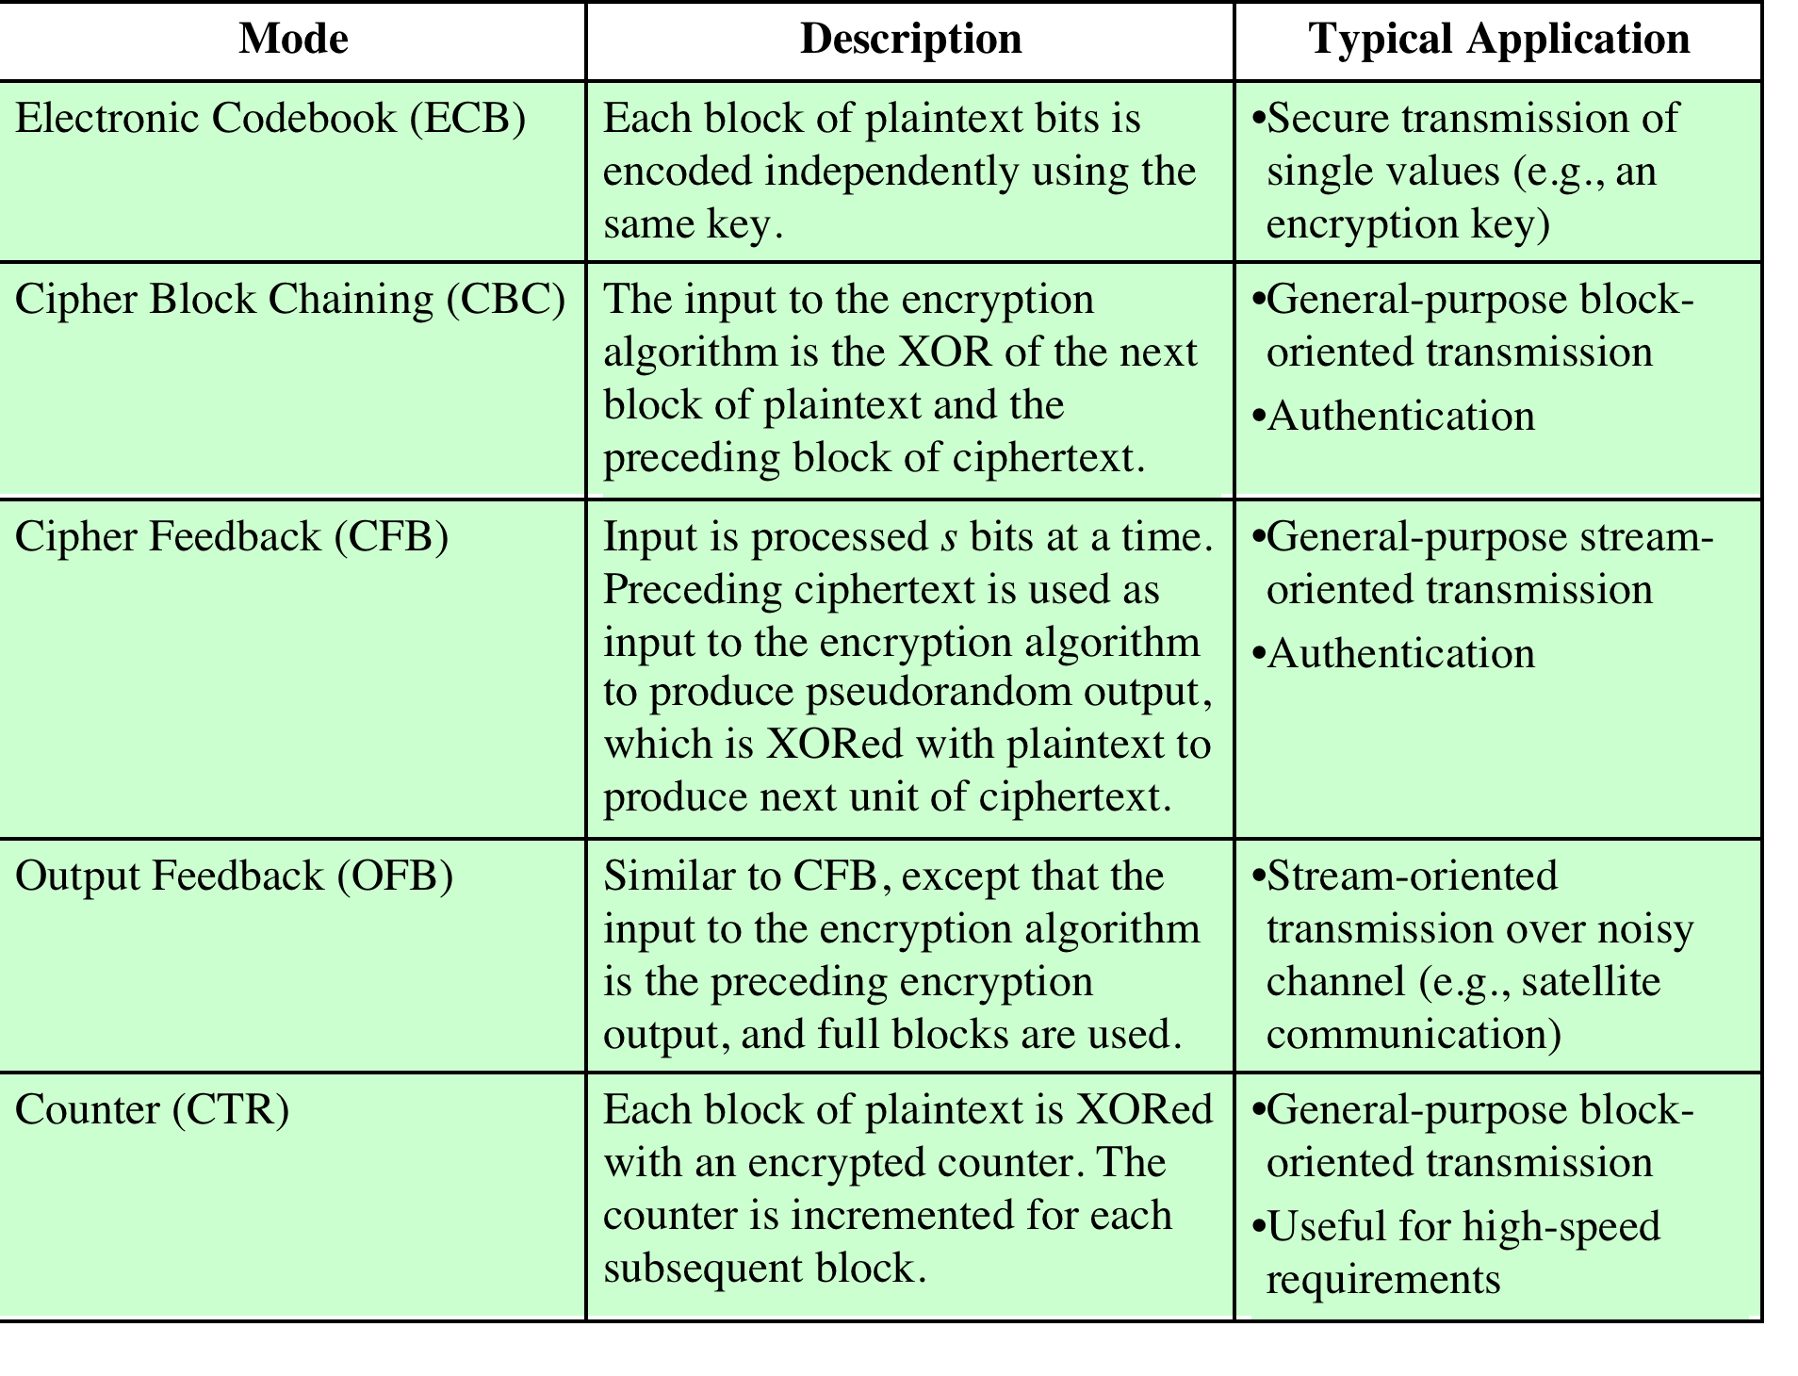
Notes:
The modes are summarized in Table 7.1 and described in this and the following sections.

Slide 5
Electronic Code Book -ECB
The simplest mode is the electronic codebook (ECB) mode,
Plaintext is handled one block at a time and each block of plaintext is encrypted using the same key.
The term codebook is used because, for a given key, there is a unique ciphertext for every b -bit block of plaintext.
The ECB method is ideal for a short amount of data, such as an encryption key. Thus, if you want to transmit a DES or AES key securely, ECB is the appropriate mode to use.
Notes:
Therefore, we can imagine a
gigantic codebook in which there is an entry for every possible b -bit plaintext pattern
showing its corresponding ciphertext.

Slide 6
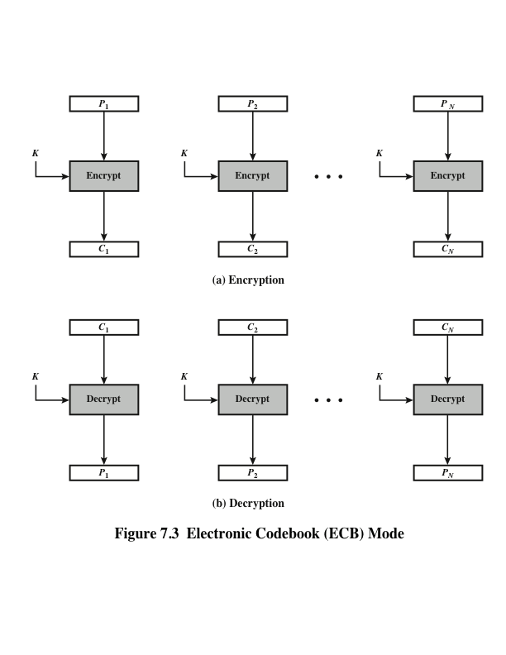
Notes:
For a message longer than b bits, the procedure is simply to break the message
into b -bit blocks, padding the last block if necessary. Decryption is performed one
block at a time, always using the same key. In Figure 7.3, the plaintext (padded as
necessary) consists of a sequence of b -bit blocks, P₁ , P₂ , . . . , P_{N} ; the corresponding
sequence of ciphertext blocks is C₁ , C₂ , . . . , C_{N} . We can define ECB mode as
follows.
ECB C_{j} = E(K, Pj) j = 1, . . . , N P_{j} = D(K, Cj₎ j = 1, . . . , N

Slide 7
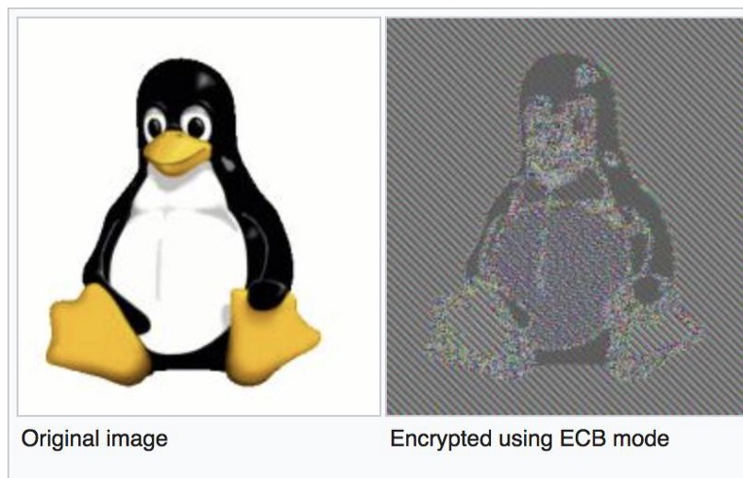
For lengthy messages, the ECB mode may not be secure. If the message is highly structured, it may be possible for a cryptanalyst to exploit these regularities.
For example, if it is known that the message always starts out with certain predefined fields, then the cryptanalyst may have a number of known plaintext– ciphertext pairs to work with.
Notes:
The most significant characteristic of ECB is that if the same b -bit block of
plaintext appears more than once in the message, it always produces the same
ciphertext.
If the message has repetitive elements with a period of repetition a multiple of b bits, then these elements can be identified by the
analyst. This may help in the analysis or may provide an opportunity for substituting
or rearranging blocks.

Slide 8

Criteria and properties for evaluating and constructing block cipher modes of operation that are superior to ECB:
Overhead
Error recovery
Error propagation
Diffusion
Security
Notes:
We now turn to more complex modes of operation. [KNUD00] lists the following
criteria and properties for evaluating and constructing block cipher modes of
operation that are superior to ECB:
• Overhead: The additional operations for the encryption and decryption
operation when compared to encrypting and decrypting in the ECB mode.
• Error recovery: The property that an error in the i th ciphertext block is inherited
by only a few plaintext blocks after which the mode resynchronizes.
• Error propagation: The property that an error in the i th ciphertext block is
inherited by the i th and all subsequent plaintext blocks. What is meant here is
a bit error that occurs in the transmission of a ciphertext block, not a computational
error in the encryption of a plaintext block.
• Diffusion: How the plaintext statistics are reflected in the ciphertext. Low
entropy plaintext blocks should not be reflected in the ciphertext blocks.
Roughly, low entropy equates to predictability or lack of randomness (see
Appendix F).
• Security: Whether or not the ciphertext blocks leak information about the
plaintext blocks.

Slide 9
Cipher Block Chaining Mode - CBC
To overcome the security deficiencies of ECB, simple way to satisfy this requirement.
The input to the encryption algorithm is the XOR of the current plaintext block and the preceding ciphertext block; the same key is used for each block.
It chains together the processing of the sequence of plaintext blocks. Therefore, repeating patterns of b bits are not exposed.
Notes:
In effect, we have The input to the encryption function for each plaintext block bears
no fixed relationship to the plaintext block.
As with the ECB mode, the CBC mode requires that the last block
be padded to a full b bits if it is a partial block.

Slide 10
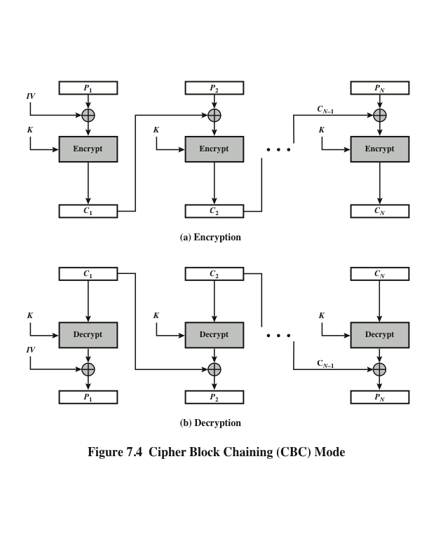
Notes:
For decryption, each cipher block is passed through the decryption algorithm.
The result is XORed with the preceding ciphertext block to produce the plaintext
block.
In conclusion, because of the chaining mechanism of CBC, it is an appropriate
mode for encrypting messages of length greater than b bits.

Slide 11
Cipher Block Chaining Mode - CBC
To produce the first block of ciphertext, an initialization vector (IV) is XORed with the first block of plaintext.
On decryption, the IV is XORed with the output of the decryption algorithm to recover the first block of plaintext. The IV is a data block that is the same size as the cipher block.
The IV must be known to both the sender and receiver but be unpredictable by a third party. In particular, for any given plaintext, it must not be possible to predict the IV that will be associated to the plaintext in advance of the generation of the IV.
The IV can be sent using ECB encryption.
One reason for protecting the IV is as follows: If an opponent is able to fool the receiver into using a different value for IV, then the opponent is able to invert selected bits in the first block of plaintext.
Notes:
So long as it is unpredictable, the specific choice of IV is unimportant. SP800-38A recommends two possible methods: The first method is to apply the encryption function, under the same key that is used for the encryption of the plaintext, to a nonce . The nonce must be a data block that is unique to each execution of the encryption operation. For example, the nonce may be a counter, a timestamp, or a message number. The second method is to generate a random data block using a random number generator.

Slide 12
Cipher Feedback Mode
There are three modes that make it possible to convert a block cipher into a stream cipher:
Cipher feedback (CFB) mode
Output feedback (OFB) mode
Counter (CTR) mode
For AES, DES, or any block cipher, encryption is performed on a block of b bits
In the case of DES b = 64
In the case of AES b = 128
Stream Cipher
Eliminates the need for padding,
Can operate in the real time.
Notes:
One desirable property of a stream cipher is that the ciphertext be of the same
length as the plaintext. Thus, if 8-bit characters are being transmitted, each character
should be encrypted to produce a ciphertext output of 8 bits. If more than 8 bits
are produced, transmission capacity is wasted.

Slide 13
Cipher Feedback Mode
As with CBC, the units of plaintext are chained together, so that the ciphertext of any plaintext unit is a function of all the preceding plaintext.
In this case, rather than blocks of b bits, the plaintext is divided into segments of s bits.
A common value is s = 8.
CFB-1, CFB-8, CFB-64 ,CFB-128

Slide 14
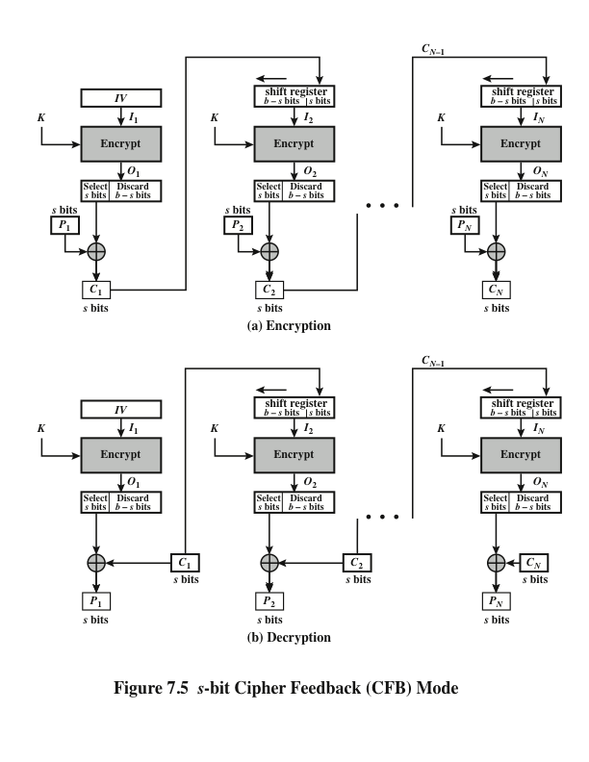
Notes:
Figure 7.5 depicts the CFB scheme. In the figure, it is assumed that the unit of
transmission is s bits;
First, consider encryption. Happens in 4 steps. The input to the encryption function is a b -bit shift
register that is initially set to some initialization vector (IV). The leftmost (most
significant) s bits of the output of the encryption function are XORed with the
first segment of plaintext P₁ to produce the first unit of ciphertext C₁ , which is then
transmitted. In addition, the contents of the shift register are shifted left by s bits,
and C₁ is placed in the rightmost (least significant) s bits of the shift register. This
process continues until all plaintext units have been encrypted.
For decryption, the same scheme is used, except that the received ciphertext
unit is XORed with the output of the encryption function to produce the plaintext
unit. Note that it is the encryption function that is used, not the decryption function.

Slide 15
Cipher Feedback Mode
Although CFB can be viewed as a stream cipher, it does not conform to the typical construction of a stream cipher.
In a typical stream cipher, the cipher takes as input some initial value and a key and generates a stream of bits, which is then XORed with the plaintext bits. In the case of CFB, the stream of bits that is XORed with the plaintext also depends on the plaintext.
In CFB encryption, like CBC encryption, the input block to each forward Cipher function (except the first) depends on the result of the previous forward Cipher function; therefore, multiple forward cipher operations cannot be performed in parallel.
In CFB decryption, the required forward cipher operations can be performed in parallel if the input blocks are first constructed (in series) from the IV and the ciphertext.

Slide 16
Output Feedback Mode
The output feedback (OFB) mode is similar in structure to that of CFB.
The other difference is that the OFB mode operates on full blocks of plaintext and ciphertext, whereas CFB operates on an s-bit subset.
For OFB, the output of the encryption function is fed back to become the input for encrypting the next block of plaintext.

Slide 17
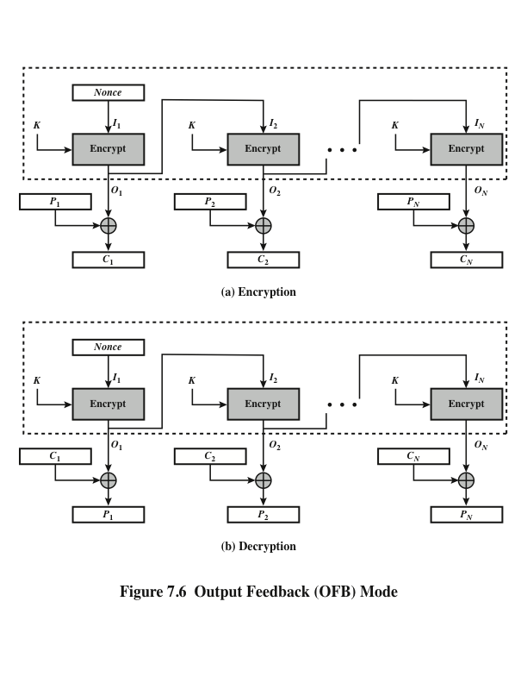
Can be calculated before hand.
Notes:
In CFB, the output of the XOR unit is fed back to become input for encrypting the next block.
As with CBC and CFB, the OFB mode requires an initialization vector. In
the case of OFB, the IV must be a nonce; that is, the IV must be unique to each
execution of the encryption operation. The reason for this is that the sequence of
encryption output blocks, O_{i} , depends only on the key and the IV and does not depend
on the plaintext. Therefore, for a given key and IV, the stream of output bits
used to XOR with the stream of plaintext bits is fixed. If two different messages had
an identical block of plaintext in the identical position, then an attacker would be
able to determine that portion of the O_{i} stream.

Slide 18
Nonces
A nonce is a number used once
Must be
unique: never used before in lifetime of system
and/or (depending on intended usage)
unpredictable: attacker can't guess next nonce given all previous nonces in lifetime of system

Slide 19
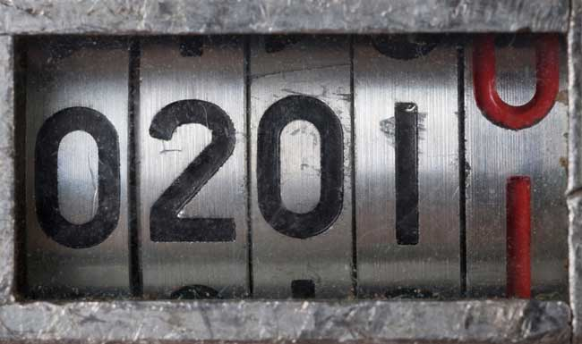

Nonce sources
counter
requires state
easy to implement
can overflow
highly predictable
clock: just a counter
random number generator
might not be unique, unless drawn from large space
might or might not be unpredictable
generating randomness:
standard library generators often are not cryptographically strong, i.e., unpredictable by attackers

Slide 20
Output Feedback Mode
One advantage of the OFB method is that bit errors in transmission do not propagate.
For example, if a bit error occurs in C₁ , only the recovered value of P₁ is affected; subsequent plaintext units are not corrupted. With CFB, C₁ also serves as input to the shift register and therefore causes additional corruption downstream.
The disadvantage of OFB is that it is more vulnerable to a message stream modification attack than is CFB.
Consider that complementing a bit in the ciphertext complements the corresponding bit in the recovered plaintext. Thus, controlled changes to the recovered plaintext can be made. This may make it possible for an opponent, by making the necessary changes to the checksum portion of the message as well as to the data portion, to alter the ciphertext in such a way that it is not detected by an error-correcting code.

Slide 21
Output Feedback Mode
OFB has the structure of a typical stream cipher.
The generated stream that is XORed with the plaintext is itself independent of the plaintext.
One distinction from the stream ciphers is that OFB encrypts plaintext a full block at a time, where typically a block is 64 or 128 bits. Many stream ciphers encrypt one byte at a time.
Notes:
OFB has the structure of a typical stream cipher, because the cipher generates a stream of bits as a function of an initial value and a key, and that stream of bits is XORed with the plaintext bits.

Slide 22
Counter Mode - CTR
Idea: derive one-time pad from increasing counter
CTR is used in ATM (asynchronous transfer mode) network security and IP sec (IP security),
For encryption, the counter is encrypted and then XORed with the plaintext block to produce the ciphertext block; there is no chaining.

Slide 23
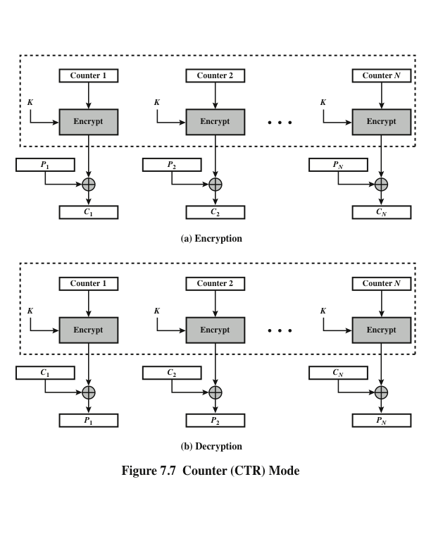
Notes:
A counter equal to the plaintext block size is used. The only requirement stated in SP 800-38A is that the counter value
must be different for each plaintext block that is encrypted. Typically, the counter
is initialized to some value and then incremented by 1 for each subsequent block
(modulo 2^{b} , where b is the block size). For encryption, the counter is encrypted and
then XORed with the plaintext block to produce the ciphertext block; there is no
chaining. For decryption, the same sequence of counter values is used, with each encrypted
counter XORed with a ciphertext block to recover the corresponding plaintext
block. Thus, the initial counter value must be made available for decryption.

Slide 24
Counter Mode - CTR
As with the OFB mode, the initial counter value must be a nonce.
T₁ must be different for all of the messages encrypted using the same key. Further, all T_{i} values across all messages must be unique.
If any plaintext block that is encrypted using a given counter value is known, then the output of the encryption function can be determined easily from the associated ciphertext block. This output allows any other plaintext blocks that are encrypted using the same counter value to be easily recovered from their associated ciphertext blocks.
Notes:
As with the OFB mode, the initial counter value must be a nonce; that is, T₁
must be different for all of the messages encrypted using the same key. Further,
all T_{i} values across all messages must be unique. If, contrary to this requirement, a
counter value is used multiple times, then the confidentiality of all of the plaintext
blocks corresponding to that counter value may be compromised. In particular, if
any plaintext block that is encrypted using a given counter value is known, then
the output of the encryption function can be determined easily from the associated
ciphertext block. This output allows any other plaintext blocks that are encrypted
using the same counter value to be easily recovered from their associated ciphertext
blocks.
One way to ensure the uniqueness of counter values is to continue to increment
the counter value by 1 across messages. That is, the first counter value of the
each message is one more than the last counter value of the preceding message.

Slide 25

Advantages of CTR
Hardware efficiency
Software efficiency
Preprocessing
Random access
Provable security
Simplicity
Notes:
[LIPM00] lists the following advantages of CTR mode.
• Hardware efficiency: Unlike the three chaining modes, encryption (or decryption)
in CTR mode can be done in parallel on multiple blocks of plaintext or
ciphertext. For the chaining modes, the algorithm must complete the computation
on one block before beginning on the next block. This limits the maximum
throughput of the algorithm to the reciprocal of the time for one execution of
block encryption or decryption. In CTR mode, the throughput is only limited
by the amount of parallelism that is achieved.
• Software efficiency: Similarly, because of the opportunities for parallel execution
in CTR mode, processors that support parallel features, such as aggressive
pipelining, multiple instruction dispatch per clock cycle, a large number of
registers, and SIMD instructions, can be effectively utilized.
• Preprocessing: The execution of the underlying encryption algorithm does
not depend on input of the plaintext or ciphertext. Therefore, if sufficient
memory is available and security is maintained, preprocessing can be used to
prepare the output of the encryption boxes that feed into the XOR functions,
as in Figure 7.7. When the plaintext or ciphertext input is presented, then
the only computation is a series of XORs. Such a strategy greatly enhances
throughput.
• Random access: The ith block of plaintext or ciphertext can be processed in
random-access fashion. With the chaining modes, block C_{i} cannot be computed
until the i - 1 prior block are computed. There may be applications in
which a ciphertext is stored and it is desired to decrypt just one block; for such
applications, the random access feature is attractive.
• Provable security: It can be shown that CTR is at least as secure as the other
modes discussed in this section.
• Simplicity: Unlike ECB and CBC modes, CTR mode requires only the implementation
of the encryption algorithm and not the decryption algorithm.
This matters most when the decryption algorithm differs substantially from
the encryption algorithm, as it does for AES. In addition, the decryption key
scheduling need not be implemented.

Slide 26
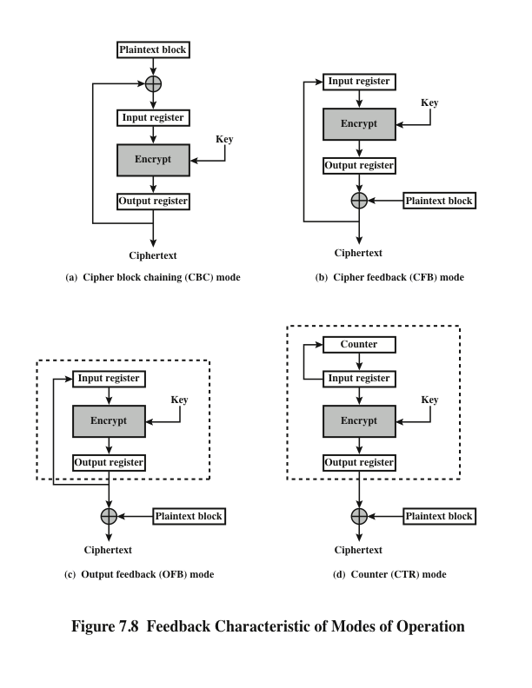
The input register is updated one block at a time by the feedback mechanism.
Notes:
Note that, with the exception of ECB, all of the NIST-approved block
cipher modes of operation involve feedback. This is clearly seen in Figure 7.8. To
highlight the feedback mechanism, it is useful to think of the encryption function
as taking input from a input register whose length equals the encryption block
length and with output stored in an output register. The input register is updated
one block at a time by the feedback mechanism. After each update, the encryption
algorithm is executed, producing a result in the output register. Meanwhile,
a block of plaintext is accessed. Note that both OFB and CTR produce output
that is independent of both the plaintext and the ciphertext. Thus, they are natural
candidates for stream ciphers that encrypt plaintext by XOR one full block
at a time.

Slide 27
XTS-AES Mode for Block-Oriented Storage Devices
Approved as an additional block cipher mode of operation by NIST in 2010
XEX Based Tweakable Codebook Mode with Ciphertext Stealing (XOR-Encrypt-XOR)
Mode is also an IEEE Standard, IEEE Std 1619-2007
Standard describes a method of encryption for data stored in sector-based devices where the threat model includes possible access to stored data by the adversary
Has received widespread industry support
Notes:
In 2010, NIST approved an additional block cipher mode of operation, XTS-AES.
This mode is also an IEEE standard, IEEE Std 1619-2007, which was developed
by the IEEE Security in Storage Working Group (P1619). The standard describes
a method of encryption for data stored in sector-based devices where the threat
model includes possible access to stored data by the adversary. The standard has
received widespread industry support.

Slide 28
Tweakable Block Ciphers
XTS-AES mode is based on the concept of a tweakable block cipher
General structure:
Has three inputs:
Tweak need not be kept secret
Purpose is to provide variability
C = E(K , T , P )
A
plaintext
P
A symmetric key
K
A
tweak
T
Produces
a ciphertext output
C
Notes:
Before examining XTS-AES, let us consider the general structure of a tweakable
block cipher. A tweakable block cipher is one that has three inputs: a plaintext P ,
a symmetric key K , and a tweak T ; and produces a ciphertext output C . We can
write this as C = E(K , T , P ). The tweak need not be kept secret. Whereas the purpose
of the key is to provide security, the purpose of the tweak is to provide variability.
That is, the use of different tweaks with the same plaintext and same key
produces different outputs.

Slide 29
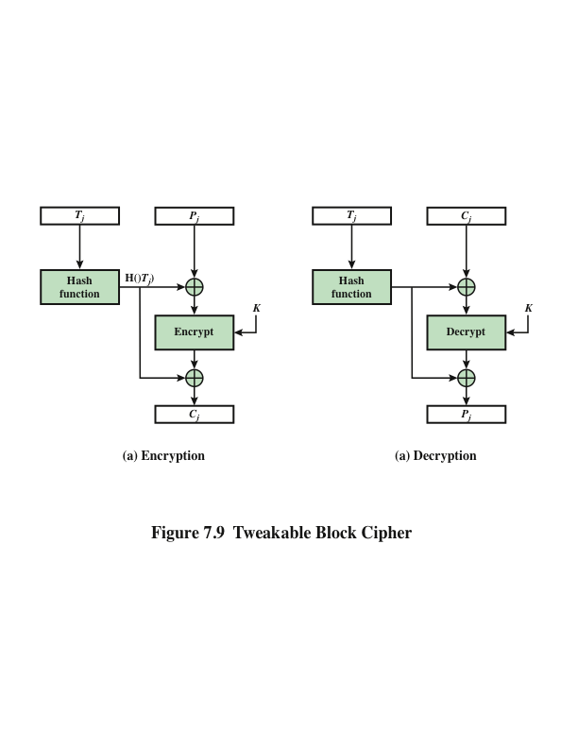
Notes:
The basic structure of several tweakable clock ciphers
that have been implemented is shown in Figure 7.9.

Slide 30
Storage Encryption Requirements
The requirements for encrypting stored data, also referred to as “data at rest”, differ somewhat from those for transmitted data
The stored data have the following characteristics:
The ciphertext is freely available for an attacker,
The data layout is not changed on the storage medium and in transit,
Data are accessed in fixed sized blocks, independently from each other,
Encryption is performed in 16-byte blocks, independently from each other,
There are no other metadata used, except the location of the data blocks within the whole data set,
The same plaintext is encrypted to different ciphertexts at different locations, but always to the same ciphertext when written to the same location again,
A standard conformant device can be constructed for decryption of data encrypted by another standard conformant device.
Notes:
The requirements for encrypting stored data, also referred to as “data at rest” differ
somewhat from those for transmitted data. The P1619 standard was designed to
have the following characteristics:
1. The ciphertext is freely available for an attacker. Among the circumstances
that lead to this situation:
a. A group of users has authorized access to a database. Some of the records in
the database are encrypted so that only specific users can successfully read/
write them. Other users can retrieve an encrypted record but are unable to
read it without the key.
b. An unauthorized user manages to gain access to encrypted records.
c. A data disk or laptop is stolen, giving the adversary access to the encrypted
data.
2. The data layout is not changed on the storage medium and in transit. The encrypted
data must be the same size as the plaintext data.
3. Data are accessed in fixed sized blocks, independently from each other. That is,
an authorized user may access one or more blocks in any order.
4. Encryption is performed in 16-byte blocks, independently from other blocks
(except the last two plaintext blocks of a sector, if its size is not a multiple of
16 bytes).
5. There are no other metadata used, except the location of the data blocks
within the whole data set.
6. The same plaintext is encrypted to different ciphertexts at different locations,
but always to the same ciphertext when written to the same location again.
7. A standard conformant device can be constructed for decryption of data encrypted
by another standard conformant device.

Slide 31
Problems
The existing modes of operation for use with stored data.
For CTR mode, an adversary with write access to the encrypted media can flip any bit of the plaintext simply by flipping the corresponding ciphertext bit.
Next, consider requirement 6 and the use of CBC. To enforce the requirement that the same plaintext encrypts to different ciphertext in different locations, the IV could be derived from the sector number. Each sector contains multiple blocks. An adversary with read/write access to the encrypted disk can copy a ciphertext sector from one position to another, and an application reading the sector off the new location will still get the same plaintext sector (except perhaps the first 128 bits). For example, this means that an adversary that is allowed to read a sector from the second position but not the first can find the content of the sector in the first position by manipulating the ciphertext.
Another weakness is that an adversary can flip any bit of the plaintext by flipping the corresponding ciphertext bit of the previous block, with the side-effect of “randomizing” the previous block.
Notes:
The P1619 group

Slide 32
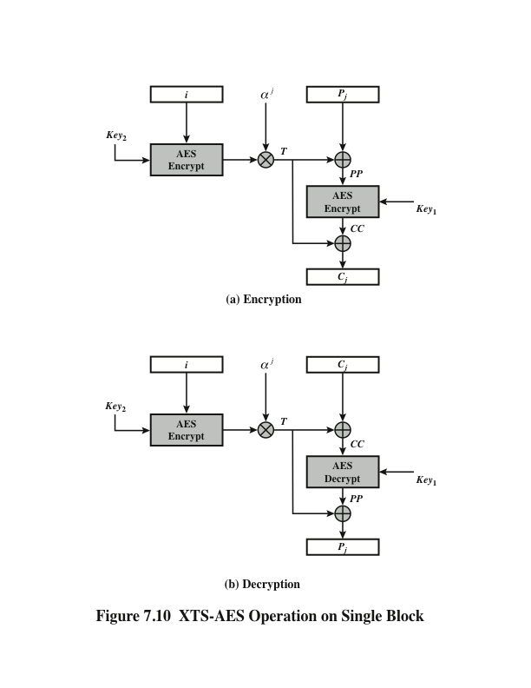
XTS-AES Operation on Single Block
Notes:
Figure 7.10 shows the encryption and decryption of a single block. The operation involves
two instances of the AES algorithm with two keys.

Slide 33
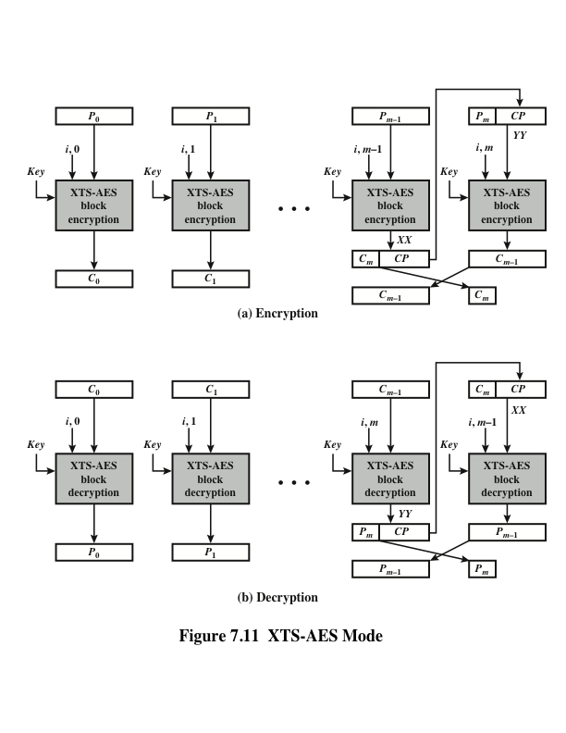
Notes:
The plaintext of a sector or data unit is organized into blocks of 128 bits. Blocks are
labeled P₀ , P₁ , . . . , P_{m} . The last block my be null or may contain from 1 to 127 bits.
In other words, the input to the XTS-AES algorithm consists of m 128-bit blocks
and possibly a final partial block.
As can be seen, XTS-AES mode, like CTR mode, is suitable for parallel operation.
Because there is no chaining, multiple blocks can be encrypted or decrypted
simultaneously. Unlike CTR mode, XTS-AES mode includes a nonce (the parameter
i ) as well as a counter (parameter j ).
For encryption and decryption, each block is treated independently and
encrypted/decrypted as shown in Figure 7.10. The only exception occurs when
the last block has less than 128 bits. In that case, the last two blocks are encrypted/
decrypted using a ciphertext-stealing technique instead of padding.
Figure 7.11 shows the scheme.

Slide 34
XTS-AES Mode
XTS-AES mode, like CTR mode, is suitable for parallel operation.
Because there is no chaining, multiple blocks can be encrypted or decrypted simultaneously.
Unlike CTR mode, XTS-AES mode includes a nonce (the parameter i ) as well as a counter (parameter j ).
The last two blocks are encrypted/ decrypted using a ciphertext-stealing technique instead of padding.

Slide 35
Padding
What if the message length isn't exactly a multiple of block length? End up with final block that isn't full:
Non-solution: pad out final block with 0's (not reversible)
Solution: Let B be the number of bytes that need to be added to final plaintext block to reach block length. Pad with B copies of the byte representing B. Called Public Key Cryptography Standards - PKCS #5 or #7 padding.
The padding will be one of:
m
01
02 02
03 03 03
04 04 04 04
05 05 05 05 05
06 06 06 06 06 06
etc.

Slide 36
Ciphertext stealing
A general method of using a block cipher mode of operation that allows for processing of messages that are not evenly divisible into blocks without resulting in any expansion of the ciphertext, at the cost of slightly increased complexity.
In order to encrypt or decrypt data, use the standard block cipher mode of operation on all but the last two blocks of data.

Slide 37
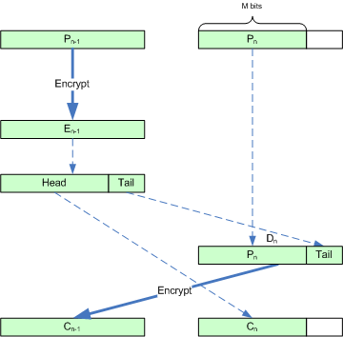
Ciphertext stealing

Slide 38
Galois/Counter Mode - GCM
NIST recently chosen to standardize GCM
NIST 800-38D, Recommendation for Block Cipher Modes of Operation: Galois/Counter Mode (GCM) and GMAC.
We want privacy and integrity from a single primitive.
Authenticated encryption combines these two separate operations into one encryption mode. E.g GCM, CCM (Counter with CBC-MAC).

Slide 39
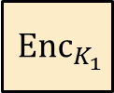
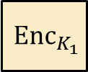









Generic composition: AE from Encryption + MAC
MAC-then-Encrypt (MtE)
Encrypt-and-MAC (E&M)
Encrypt-then-MAC (EtM)
$$M$$ | $${MAC}_{K_{2}}\left(M\right)$$
$$M$$
$$M$$
$${ Enc}_{K_{1}}$$
$${ Enc}_{K_{1}}$$
$${ Enc}_{K_{1}}$$
$$C$$
$$C$$
$${ MAC}_{K_{2}}\left(M\right)$$
$$C$$
$${MAC}_{K_{2}}\left(C\right)$$

Slide 40

Format-Preserving Encryption (FPE)
Refers to any encryption technique that takes a plaintext in a given format and produces a ciphertext in the same format
For example: credit cards consist of 16 decimal digits. An FPE that can accept this type of input would produce a ciphertext output of 16 decimal digits. (Note that the ciphertext need not be, and in fact in unlikely to be, a valid credit card number.) But it will have the same format and can be stored in the same way as credit card number plaintext.
Notes:
Format-preserving encryption (FPE) refers to any encryption technique that takes
a plaintext in a given format and produces a ciphertext in the same format. For
example, credit cards consist of 16 decimal digits. An FPE that can accept this type of
input would produce a ciphertext output of 16 decimal digits. Note that the ciphertext
need not be, and in fact is unlikely to be, a valid credit card number. But it will have
the same format and can be stored in the same way as credit card number plaintext.

Slide 41

Table 7.2 Comparison of Format-Preserving Encryption and AES
Notes:
A simple encryption algorithm is not format preserving, with the exception
that it preserves the format of binary strings. For example, Table 7.2 shows three
types of plaintext for which it might be desired to perform FPE. The third row
shows examples of what might be generated by an FPE algorithm. The fourth row
shows (in hexadecimal) what is produced by AES with a given key.

Slide 42
Motivation
FPE facilitates the retrofitting of encryption technology to legacy applications, where a conventional encryption mode might not be feasible because it would disrupt data fields/pathways
FPE has emerged as a useful cryptographic tool, whose applications include financial-information security, data sanitization, and transparent encryption of fields in legacy databases
The principal benefit of FPE is that it enables protection of particular data elements, while still enabling workflows that were in place before FPE was in use
No database schema changes and minimal application changes are required
Only applications that need to see the plaintext of a data element need to be modified and generally these modifications will be minimal
Some examples of legacy applications where FPE is desirable are:
COBOL data-processing applications
Database applications
FPE-encrypted characters can be significantly compressed for efficient transmission
Notes:
FPE facilitates the retrofitting of encryption technology to legacy applications,
where a conventional encryption mode might not be feasible because it would disrupt
data fields/pathways. FPE has emerged as a useful cryptographic tool, whose
applications include financial-information security, data sanitization, and transparent
encryption of fields in legacy databases.
The principal benefit of FPE is that it enables protection of particular data
elements in a legacy database that did not provide encryption of those data elements,
while still enabling workflows that were in place before FPE was in use. With
FPE, as opposed to ordinary AES encryption or TDEA encryption, no database
schema changes and minimal application changes are required. Only applications
that need to see the plaintext of a data element need to be modified and generally
these modifications will be minimal.
Some examples of legacy applications where FPE is desirable:
■ COBOL data-processing applications: Any changes in the structure of a record
Typical code sizes involve hundreds of modules, each containing around 5,000–10,000
lines on average.

